Slide 1
Multi-thread HTTP Server
Team: Dingzhou Wang, Tianjun Mo, Chang Cao, Enmiao Feng

Slide 2
Introduction
For this project, we implemented a multi-threaded HTTP server in Golang.
We used Goroutine (lightweight thread in Go), which can make the http server have good performance.

Slide 3
Goals
Handle HTTP request with Goroutine concurrently
Read and parse HTTP request data from TCP connection
Write response data and send back to client
Implement Route Matching (Router)
Stress test our HTTP server

Slide 4
Goroutine
Goroutines are functions or methods that run concurrently with other functions or methods. They can be thought as lightweight threads, but cost way less resources.
One feature of Golang is that it is quite easy to start a goroutine, as we can simply go function(). In our project, for example, for every request, we can start a new goroutine to handle it. All requests are processed concurrently with high efficiency.
Advantages:
Small and flexible stack size
Highly abstracted
Use channels to access shared memory

Slide 5
Port
Listening
Accept Request
Parse Request
Routing & Call business layer
main()
Register Routing Table
router.GET(url, handler)
Register handler to routing table
router.RouterMap
Store routing rules
infinity loop
c := I.Accept()
receive incoming TCP connection
Read request from connection
I:=net.Listen(“tcp”,addr)
Listen to the port
match handler with url and method
go c.serve()
Asynchronously handle connection
Parse request
(Method, URL, Header, Body...)
handler(resp, req)
Call business layer code
Notes:
Our process is like this. First of all, we register business layer handler into the routing table.

Slide 6
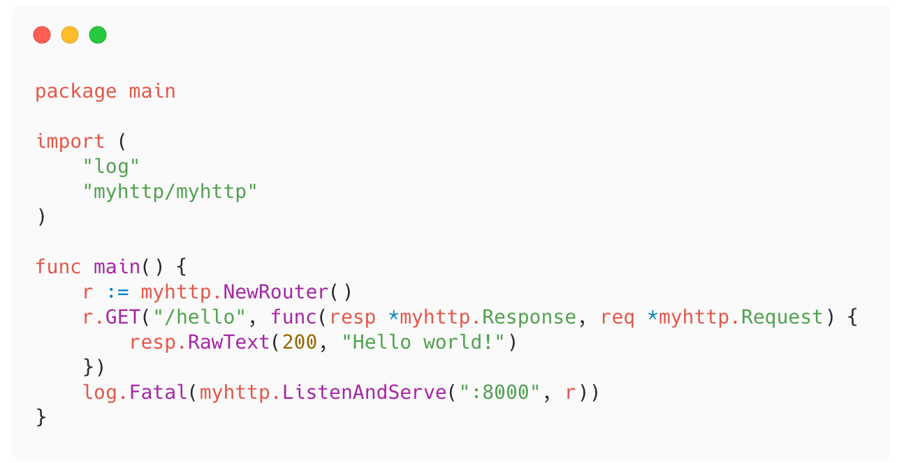
Demo
Notes:
It is very easy to use our package. We can firstly new a router, and then register business layer handler to the router, and then start to serve.

Slide 7
Challenges
Stress Test:
Selection of benchmark and load test tool:
ApacheBench
Other
Hard to generate large amount of requests
Notes:
We have challenges to select the banchmark and load test tool to test our server
For example, ApacheBench is an easy-to-use HTTP benchmark tool. But it is single-threaded, is hard to fully utilize CPU resource.
For the solution, we can use some other open-source tools written in Go to test.
We also have difficulties generating large amount of requests. In production, or in a big company, they usually have a cluster of server act as client to stress test the server. But for us, we don’t have so many resource, so it is hard to test it.

